Slide 1

ROCKBUSTER STEALTH DATA ANALYSIS
Michael Adarkwa Yeboah
20/06/2023

Slide 2

INTRODUCTION
Rockbuster Stealth LLC is a movie rental company. In the face of stiff competition, Rockbuster stealth is preparing to launch its online video rental service in order to stay competitive.
We must develop a strong launch strategy to ensure the success of this platform.

Slide 3

OUR GOAL
To inform our decisions as we build out this online catalogue, we will perform an analysis of our database to answer the following questions:
Which movies contributed the most/least to revenue gain?
What was the average rental duration for all videos?
Which countries are Rockbuster customers based in?
Where are customers with a high lifetime value based?
Do sales figures vary between geographic regions?

Slide 4
DATA OVERVIEW
The Rockbuster Stealth database contains a wealth of information. We’ve highlighted key data points below to build an overview of the database.
The average movie rental lasts about 5 days.
Number of Movies:
1000
Number of Languages:
1 (English)
Release Year of All Films:
2006
Min Rental Duration (days):
3
Max Rental Duration (days):
7
Avg Rental Duration (days):
4.985
Min Rental Rate:
$0.99
Max Rental Rate:
$4.99
Avg Rental Rate:
$2.98
Min Movie Length (min):
46
Max Movie Length (min):
185
Avg Movie Length (min):
115
Min Replacement Cost:
$9.99
Max Replacement Cost:
$29.99
Avg Replacement Cost:
$19.98

Slide 5
CONT
DATA OVERVIEW
PG-13 and NC-17 movies make up the bulk of our catalogue.
Number of G Rated Movies:
178
Number of PG Rated Movies:
194
Number of
PG-13 Rated Movies:
223
Number of R Rated Movies:
195
Number of
NC-17 Rated Movies:
210
Number of Genres:
20
Total Number of Customers:
599
Number of Active Customers:
584
Number of Inactive Customers:
15
Number of Countries w/ Customers:
109

Slide 6
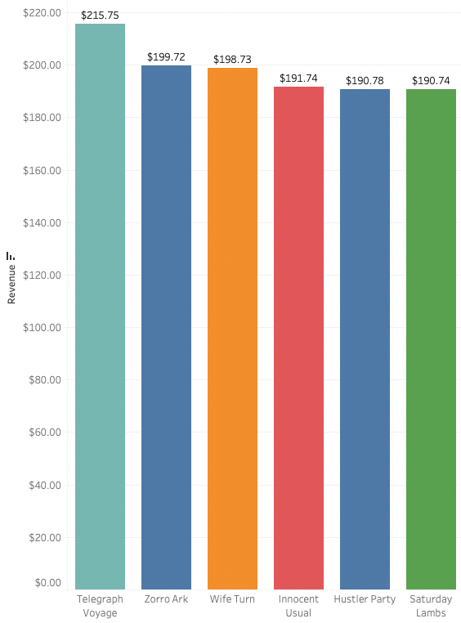
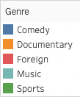
HIGHEST GROSSING FILMS
Its important to analyze which movies bring in the least and most revenue gain to create the most profitable online catalogue.
The following films brought in the most amount of revenue:
Telegraph Voyage
Zorro Ark
Wife Turn
Innocent Usual
Hustler Party
Saturday Lambs
These films must be included in our online catalogue.

Slide 7
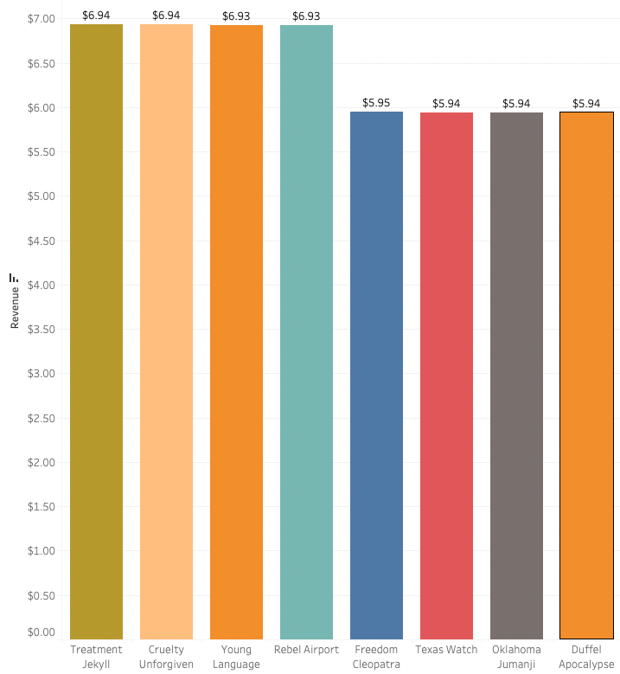
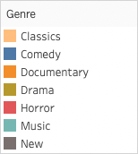
LOWEST GROSSING FILMS
The following films brought in the least amount of revenue:
Treatment Jekyll
Cruelty Unforgiven
Young Language
Rebel Airport
Freedom Cleopatra
Texas Watch
Oklahoma Jumanji
Duffel Apocalpyse

Slide 8
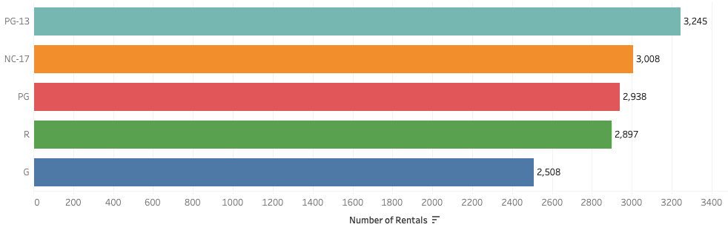
RATING POPULARITY
When we analyzed rental rates of each movie rating, we discovered that PG-13 movies are the most popular amongst our costumers, while G-rated movies are the least popular.

Slide 9
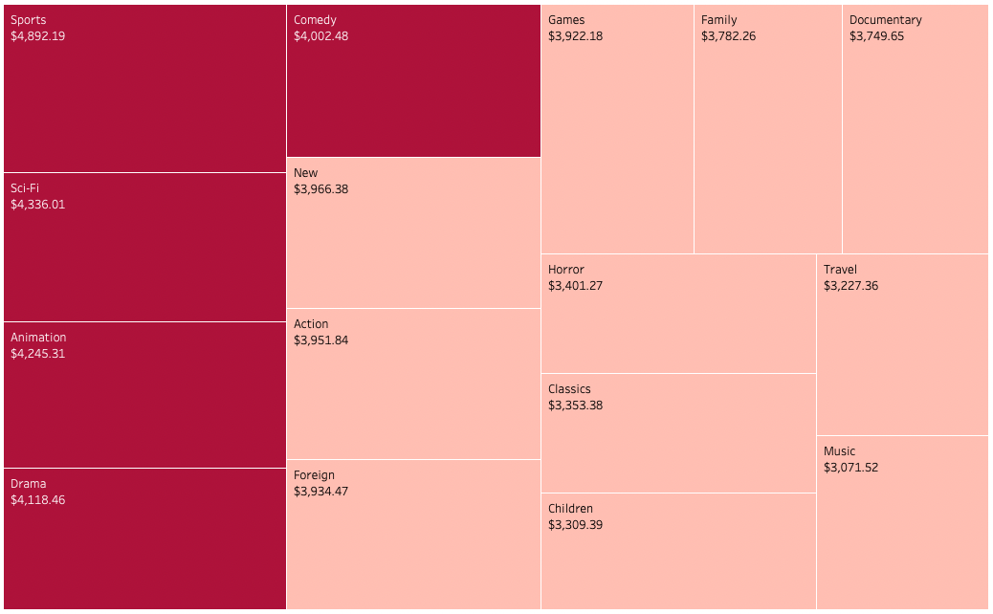
Upon analyzing the revenue by genre, these are the most popular genres:
Sports
Sci-Fi
Animation
Drama
Comedy
REVENUE BY GENRE

Slide 10
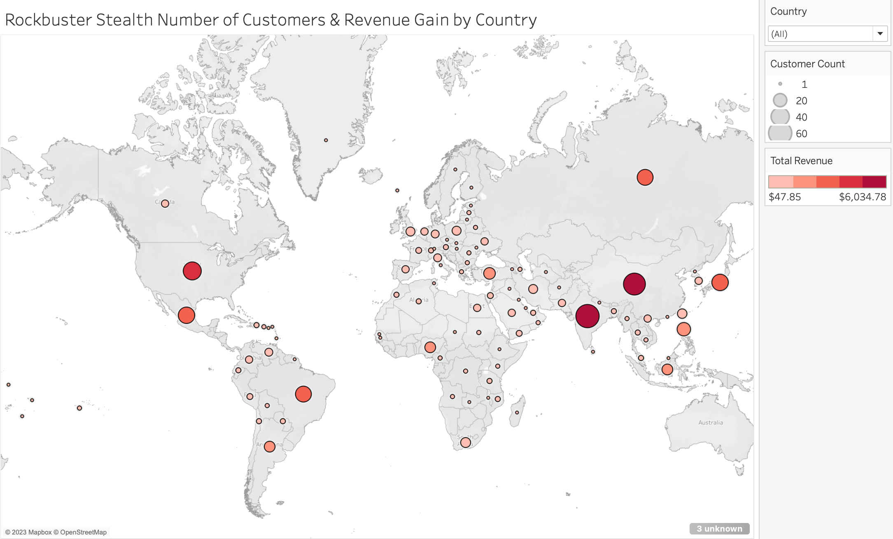
CUSTOMER DEMOGRAPHICS
Understanding our customers is crucial when building the online catalogue. Here, we can see where all Rockbuster customers are located and revenue by country.
It is evident that Rockbuster customers live throughout the entire world. Thus, creating an online catalogue will all us to reach those customers and more.

Slide 11
CUSTOMER DEMOGRAPHICS
Here, we can see more detail about customer demographics including the countries with the most customers and revenue as well as the top 5 Rockbuster customers.
 | Country | Number of Customers | Revenue
1 | India | 60 | $6,034.78
2 | China | 53 | $5,251.03
3 | United States | 36 | $3,685.31
4 | Japan | 31 | $3,122.51
5 | Mexico | 30 | $2,984.82
6 | Brazil | 28 | $2,919.19
7 | Russian Federation | 28 | $2,765.62
8 | Philippines | 20 | $2,219.70
9 | Turkey | 15 | $1,498.49
10 | Indonesia | 14 | $1,352.69
 | Customer ID | First Name | Last Name | Country | Revenue
1 | 148 | Eleanor | Hunt | Réunion | $211.55
2 | 526 | Karl | Seal | United States | $208.58
3 | 178 | Marion | Snyder | Brazil | $194.61
4 | 137 | Rhonda | Kennedy | Netherlands | $191.62
5 | 144 | Clara | Shaw | Belarus | $189.60
The customer team is looking into rewarding these customers for their loyalty.

Slide 12

CONCLUSION
All movies are in English and from 2006.
The bulk of our customers are based in India and China, however we have customers all around the world (in a total of 109 countries).
PG-13 and NC-17 make up the majority of our catalogue and are also the most rented ratings
Sports, Sci-Fi, Animation, Drama, and Comedy movies bring in the most revenue.
Top customers exist all around the world.

Slide 13

RECOMMENDATIONS
With our current findings, we believe the following recommendations will help us create a successful launch strategy:
Add foreign language movies to our catalogue, specifically those in Chinese dialects and Indian
Add more movies from other years
Prioritize marketing efforts in India, China, United States, Japan, and Mexico
Focus on adding Sports, Sci-Fi, Animation, Drama, and Comedy movies to the online catalogue
Make sure to include Telegraph Voyage, Zorro Ark, Wife Turn, Innocent Usual, Hustler Party, and Saturday Lambs in the online catalogue
Create a customer loyalty program that rewards the top customers (this could happen on a quarterly or monthly rate)

Slide 14

Thank You

